Slide 1
Contact Lens PoC Evaluation – Chat & Voice
DME Omnichannel

Slide 2
Agenda
Context
Use Cases – Displaying Customer Sentiment Details to Agent
Provide Chat Summary
- Issues Detected
- Outcome Detected
Categorizing Conversations
Discussions & Next Steps

Slide 3
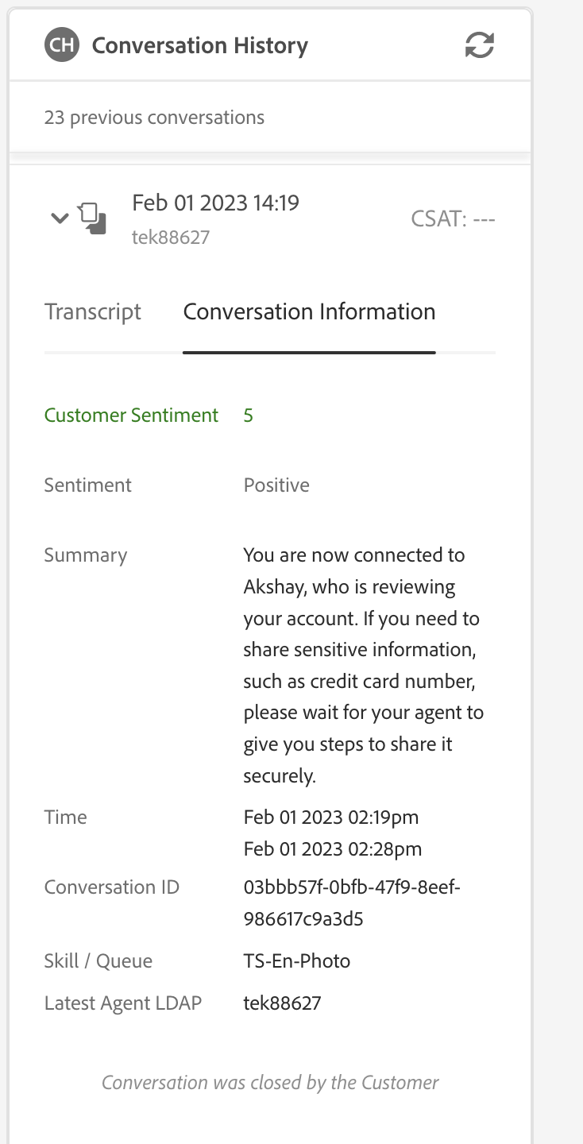
Conversational Analytics – Post Chat Transcript Analyzation
Integration of AWS Connect Contact Lens with OAC
Displaying of three new fields into Conversation History Widget
Sentiment Analysis (Customer Sentiment)
Contains Score Ranging from -5 to 5
Sentiment Type
Positive
Neutral
Negative
Chat Summary
Issues Detection
Outcome Detection

Slide 4
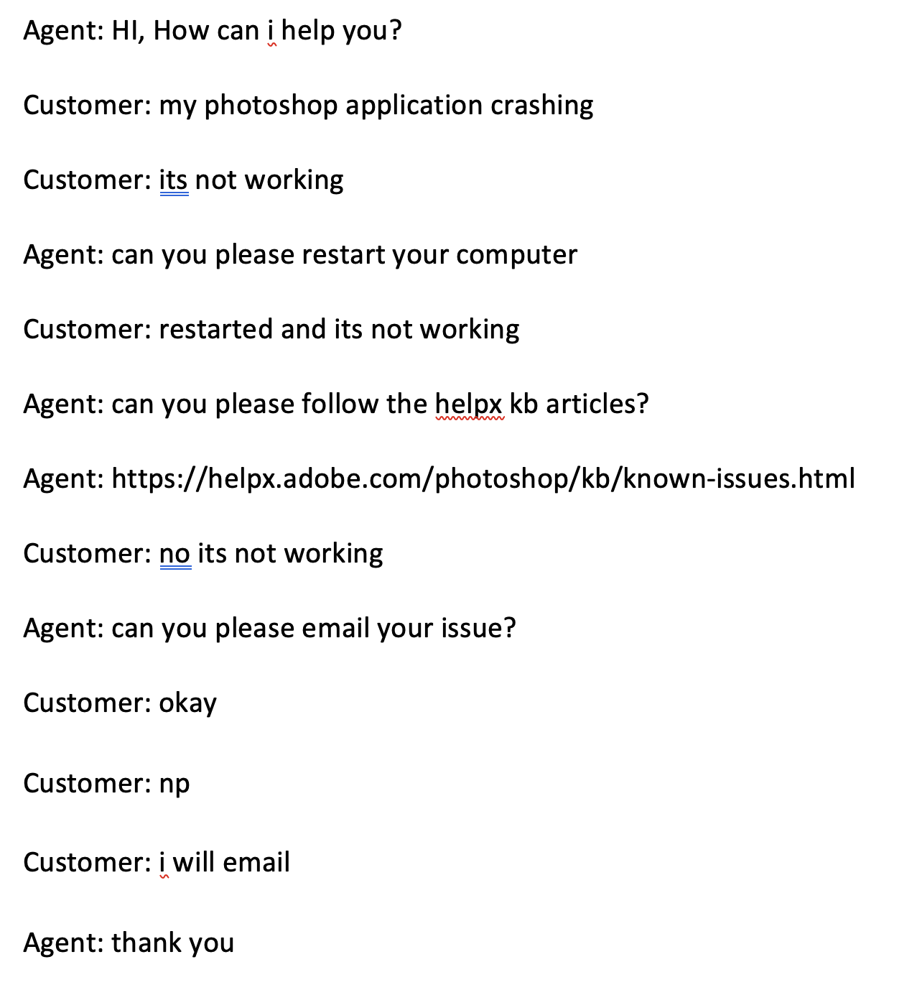
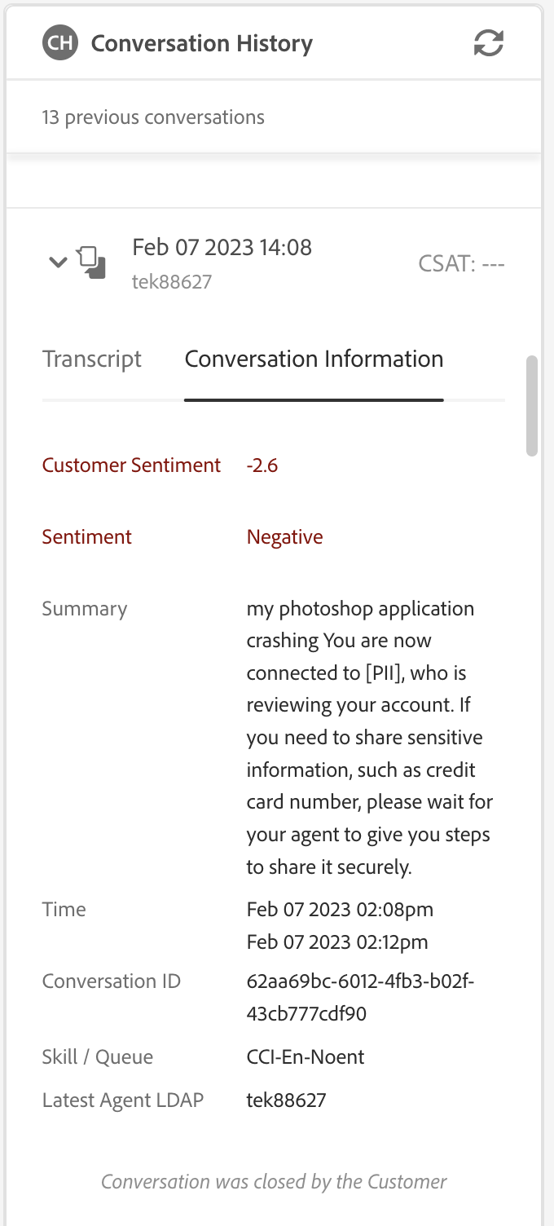
Conversational Analytics – Post Chat Transcript Analyzation (Negative)
Notes:
Summary quality -> we are working with Shefali from AWS Team to improve Chat Summary Quality

Slide 5
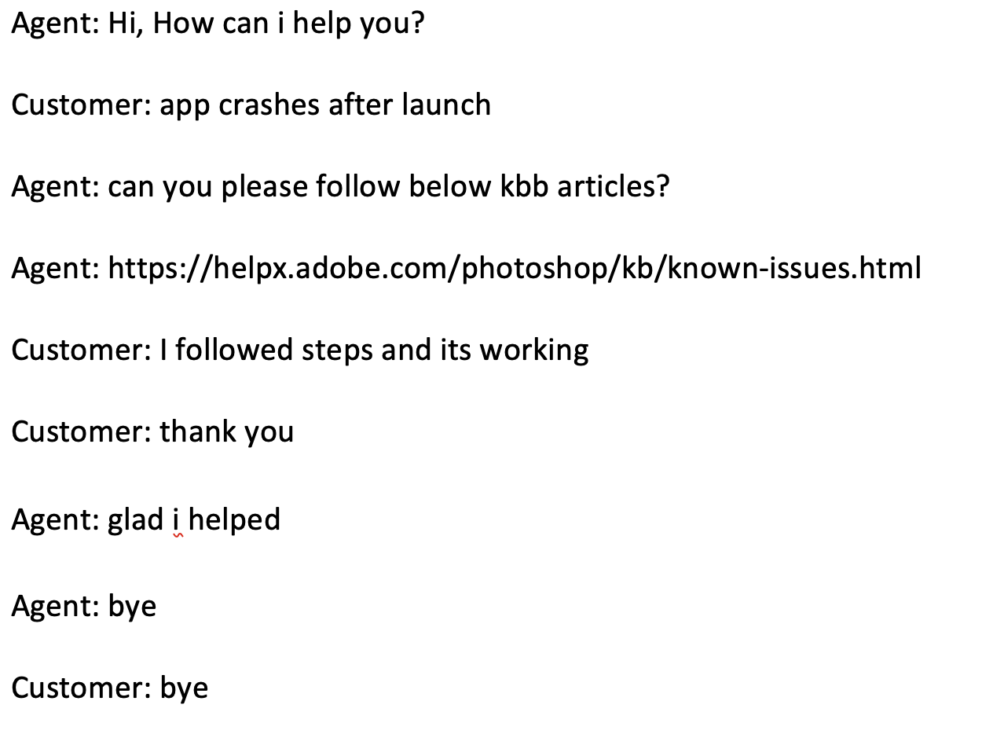
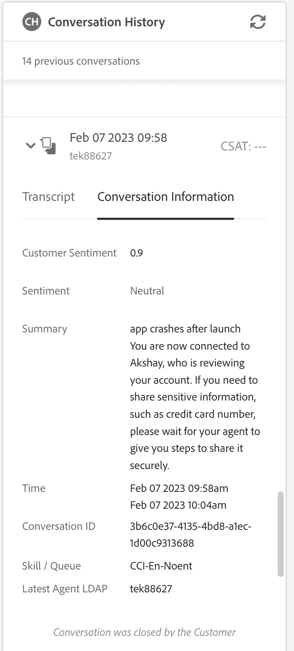
Conversational Analytics – Post Chat Transcript Analyzation (Neutral)
Notes:
Summary quality -> we are working with Shefali from AWS Team to improve Chat Summary Quality

Slide 6
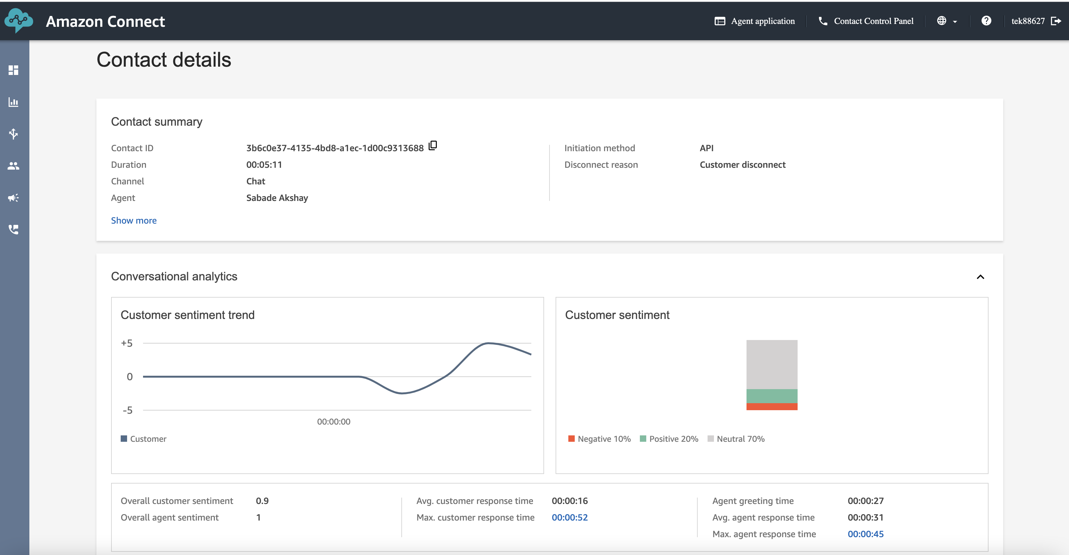
Conversational Analytics – Chat (Agent Manager Workspace)

Slide 7
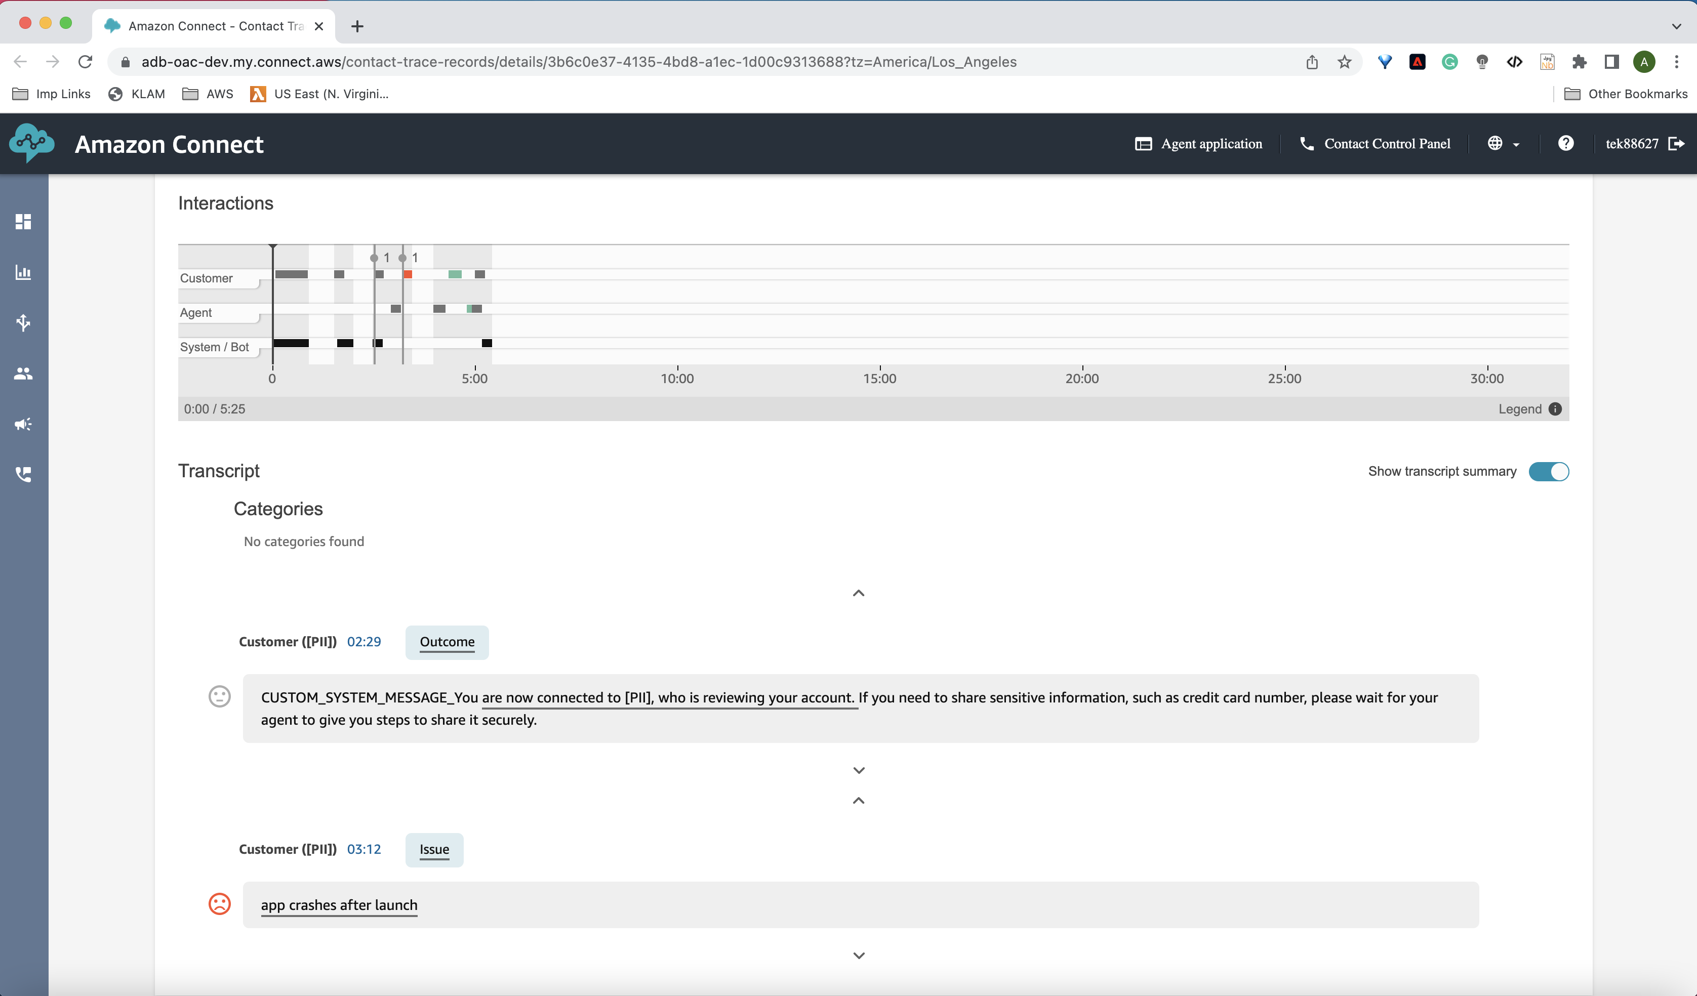
Conversational Analytics – Chat (Agent Manager Workspace)

Slide 8
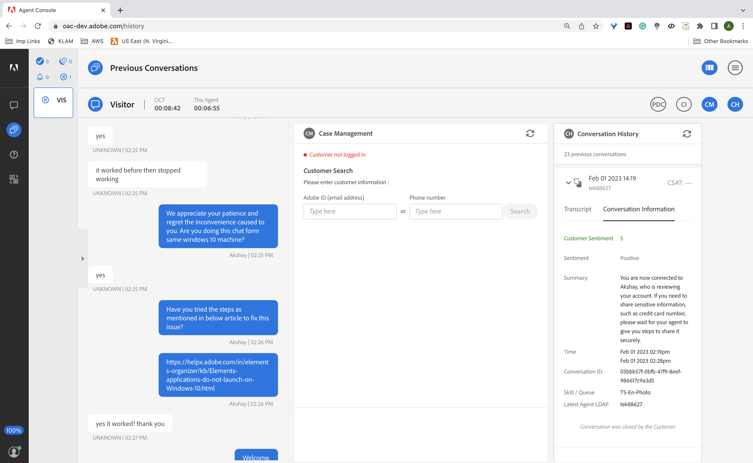
Conversational Analytics - Chat

Slide 9
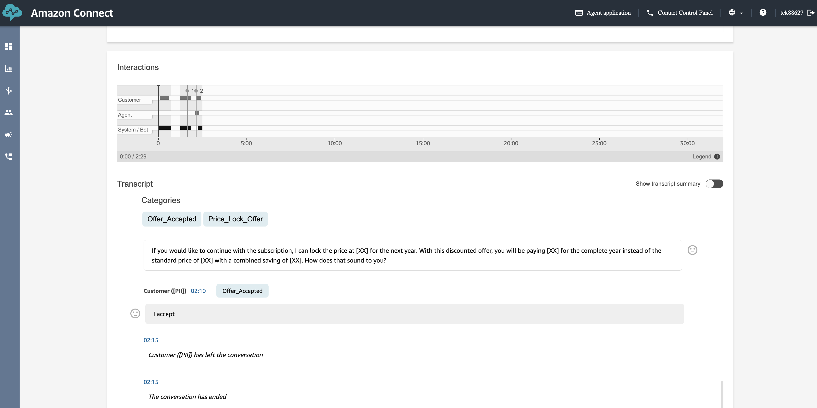
Categorizing Conversations (Agent Manager Workspace)

Slide 10
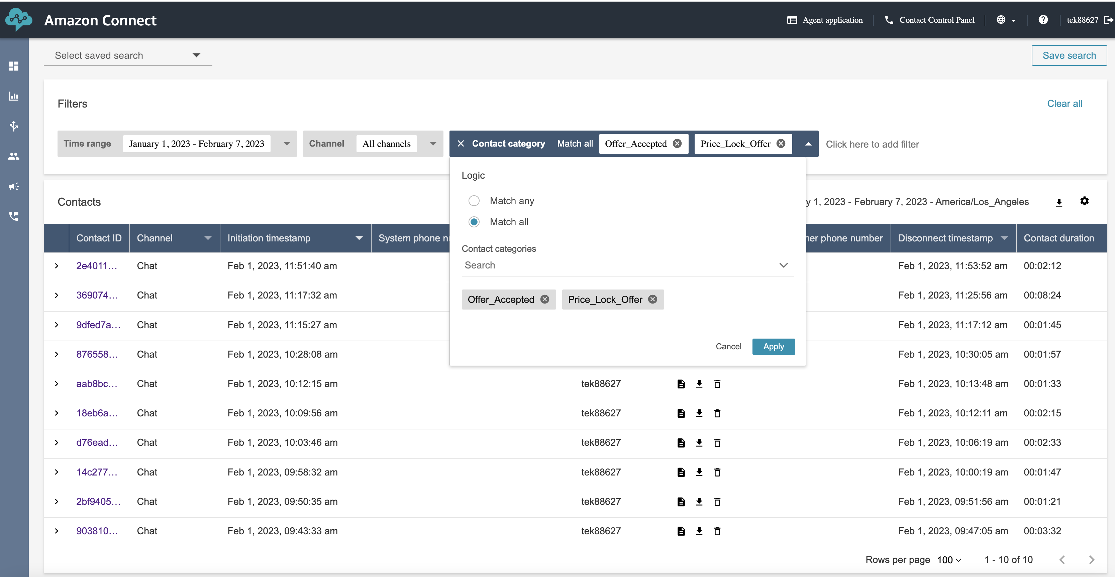
Categorizing Conversations (Agent Manager Workspace)

Slide 11
Discussions & Next Steps
Next Steps:
PoC use case discussions from the attendee
Firm up on use cases?

Slide 12
Thank You

Slide 13
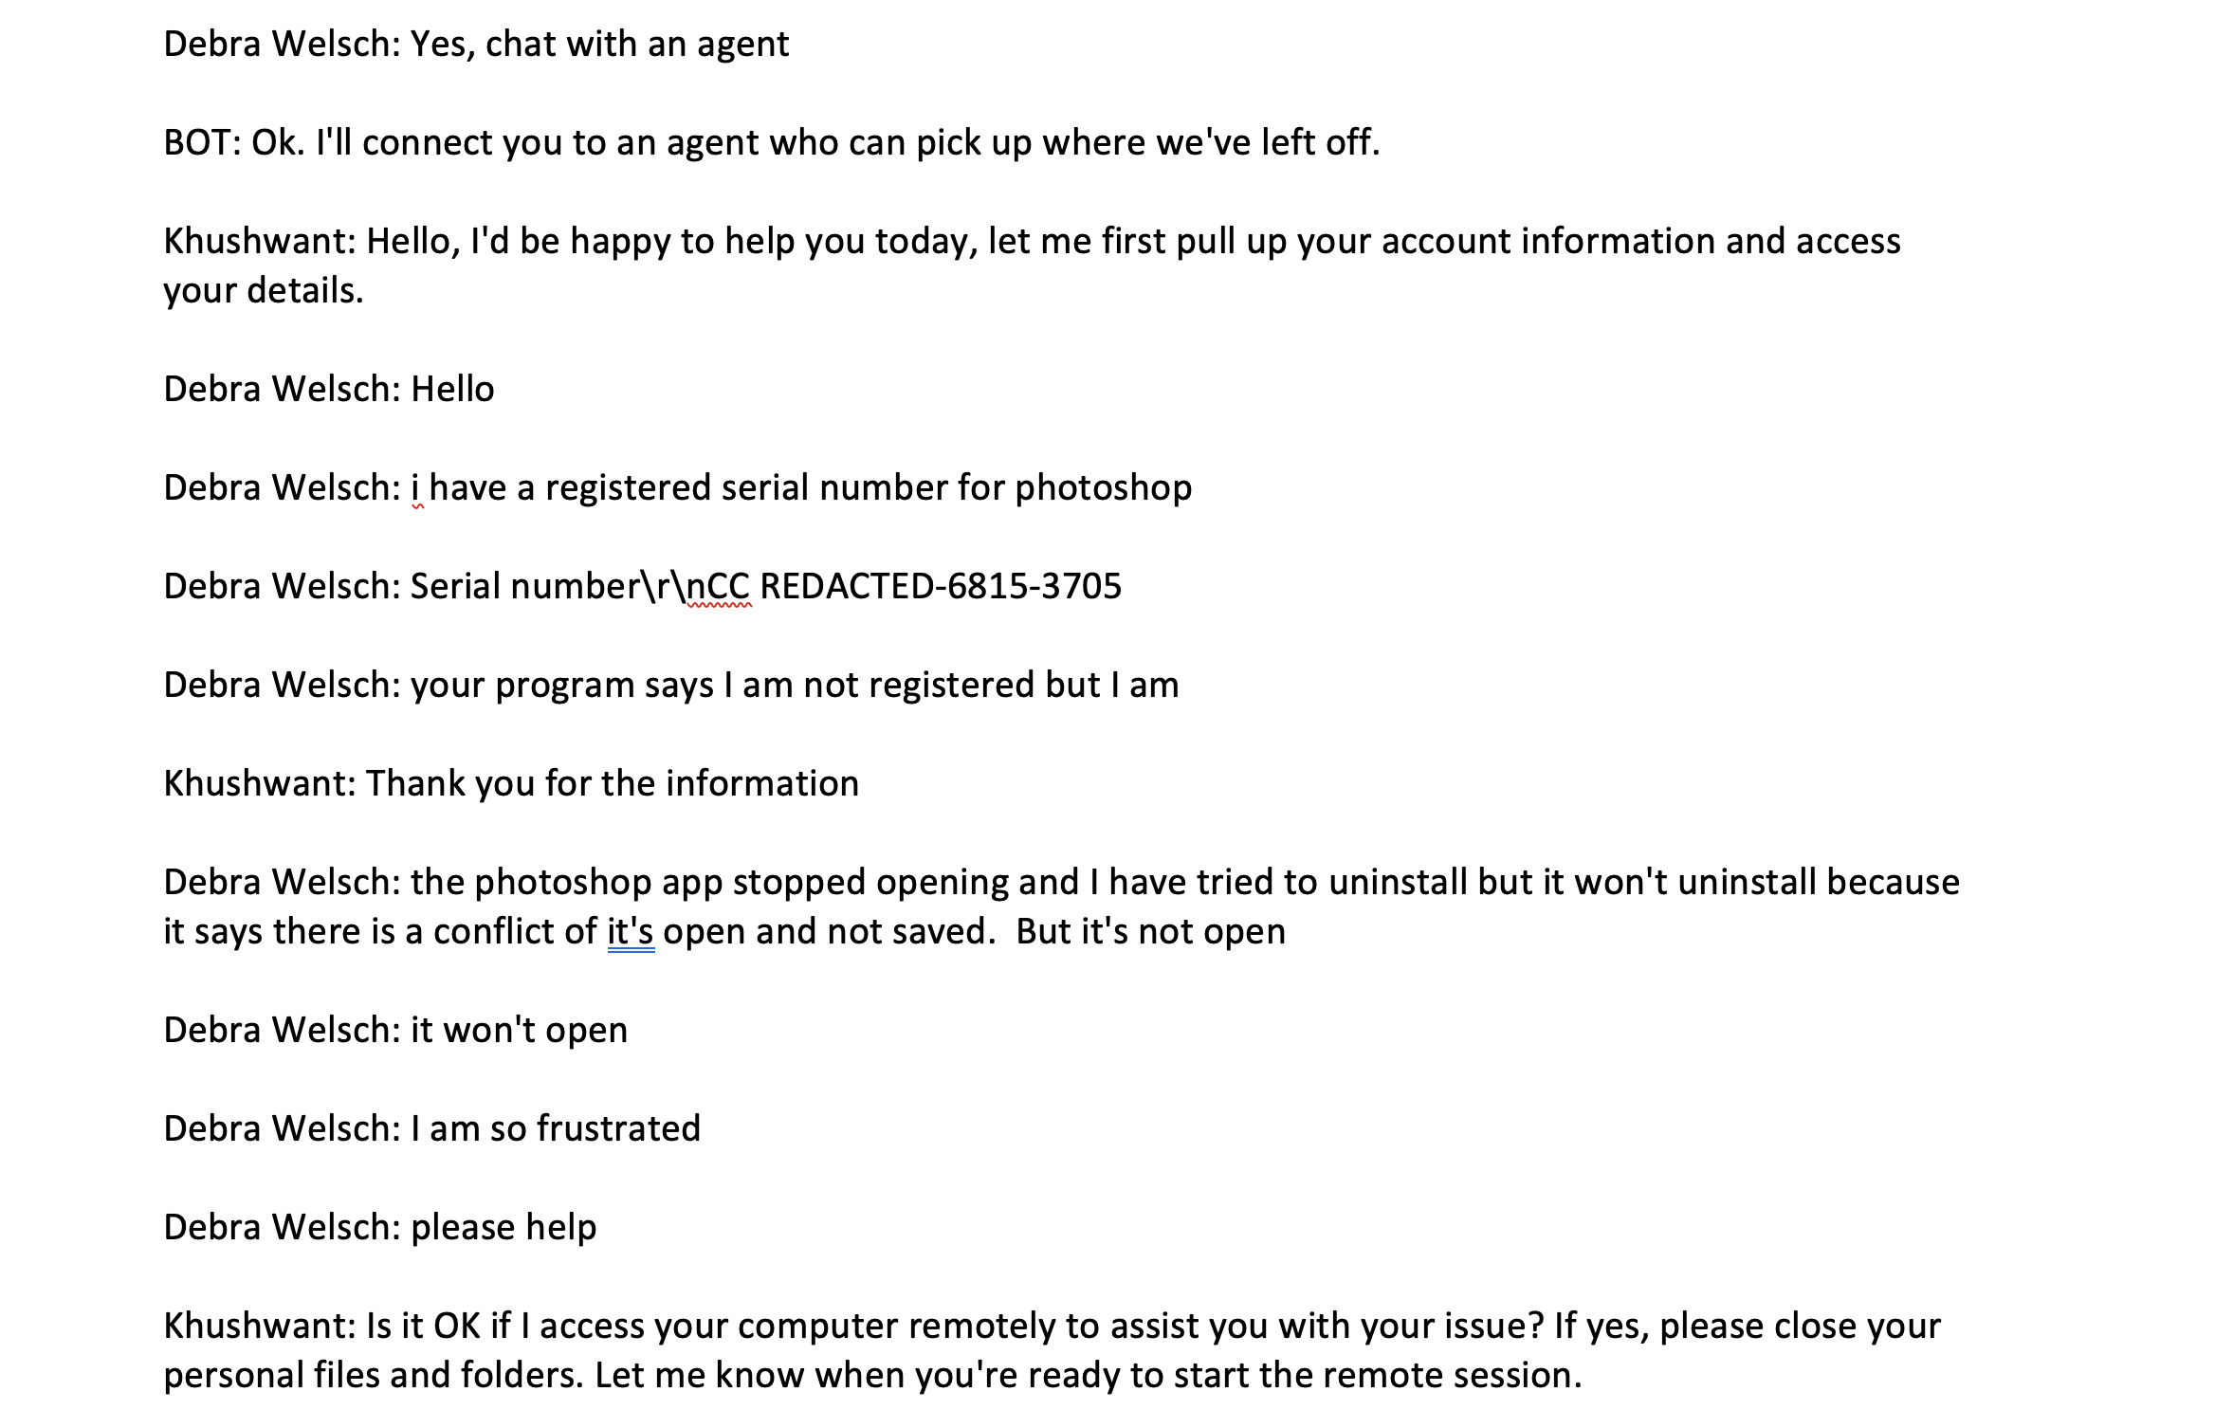
Context

Slide 14
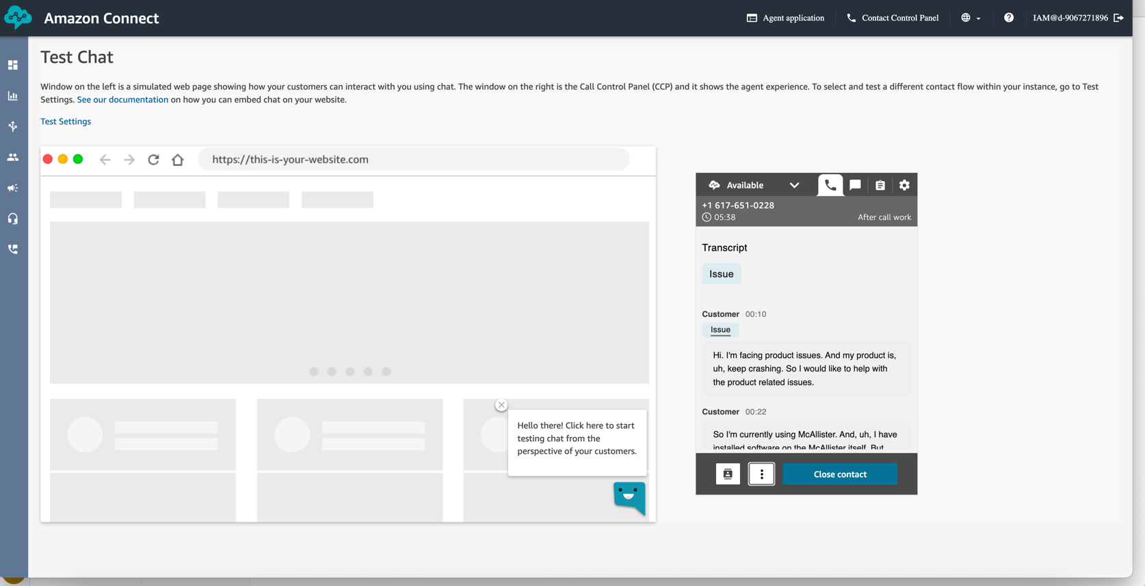
Conversational Analytics – Real-time voice

Slide 15
Potential POC Use cases
AWS Connect Contact Lens use cases
Agent Manager Workspace: Value Add Action Offers (# of agents pitched in the offer)
Agent Manager Workspace: Sentiment Analysis
Voice real time analytics -> sentiment score, transcription -> notify agent Manager if sentiment score is below NEUTRAL
Real time bot Conversation Summarization
Post chat transcript analyzation
Use Cases : https://adobe.sharepoint.com/:x:/s/SupernovaOmnichannelPlatform/EVxRER-4RAtKrN0x7EvDhP8BDpuwl86SEQLnRbK2v37YRQ?e=ncK656&CID=7dfb3303-6af1-3968-0700-49bcb0b44a80

Slide 16
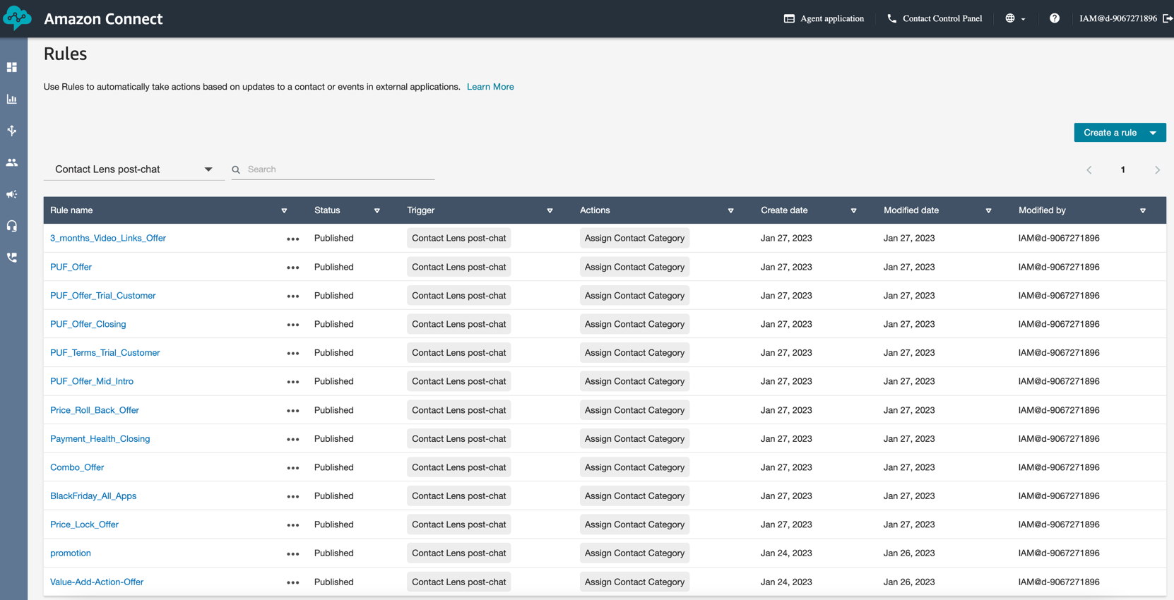
Agent Manager Workspace: Value Add Action Offers

